Slide 1

CSCI 331 - Project 1
Group 10 E
Edwin Ramos, Jay Mistry, Bing Gao, Michael Chang, Carlos Salinas, Akashdeep Singh
Notes:
Carlos

Slide 2
Member Roles
Edwin Ramos - Project Manager/ Lead Developer
Jay Mistry - Secondary Manager/ Secondary Developer
Michael Chang - Meeting Scribe
Akashdeep Singh - Group Member
Bing Gao - Group Member
Carlos Salinas - Group Member
Notes:
Carlos

Slide 3
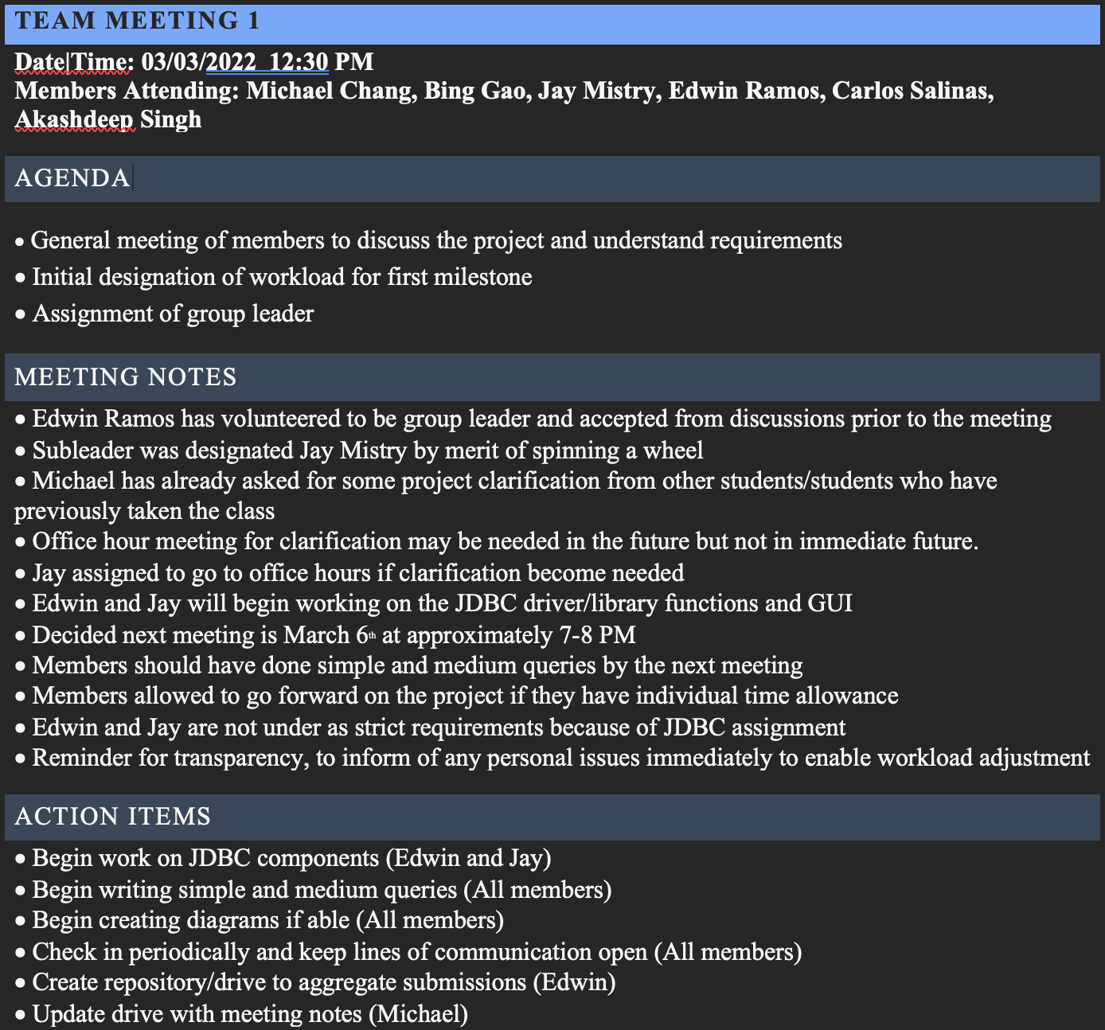
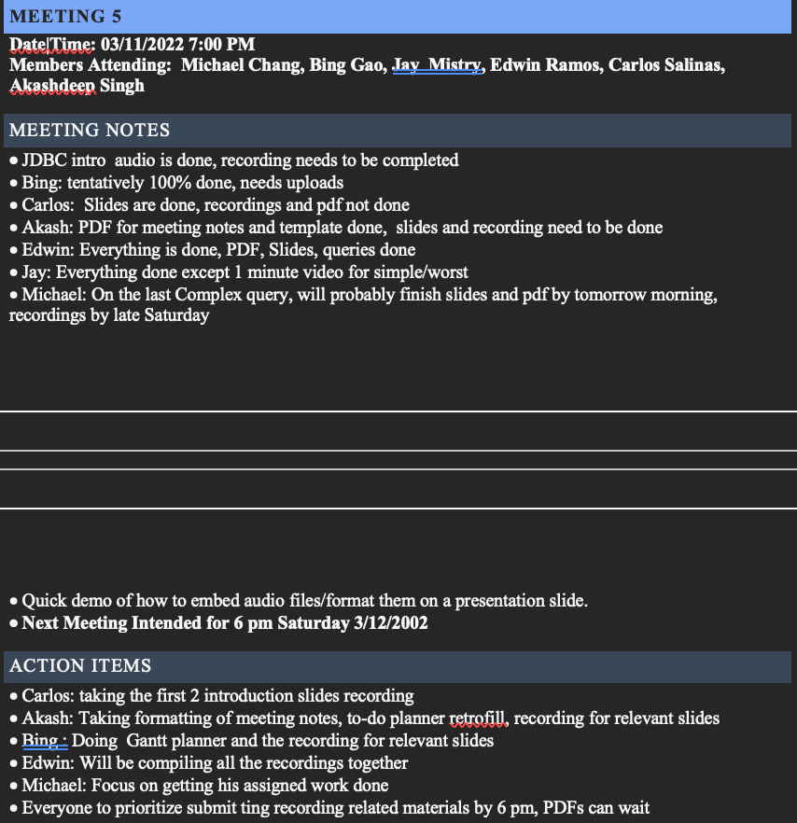
Team Agenda
Attendance for each meeting
Agenda Items for meetings purpose
Meeting notes for key information discussed
Action items for next steps

Slide 4
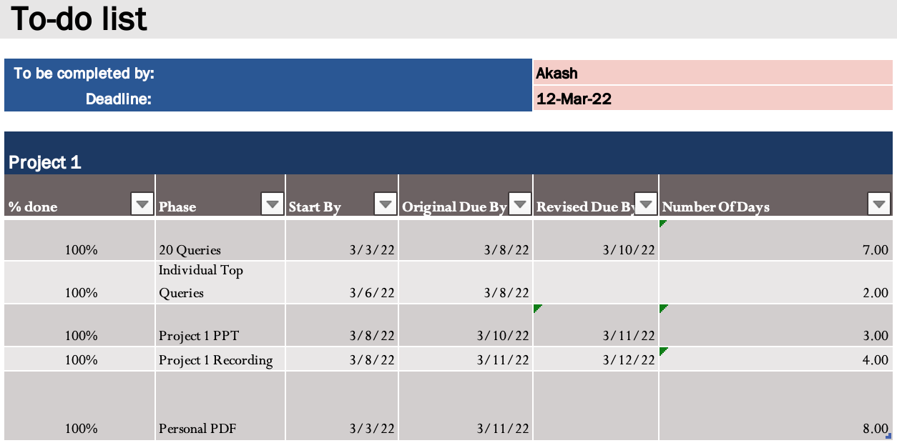
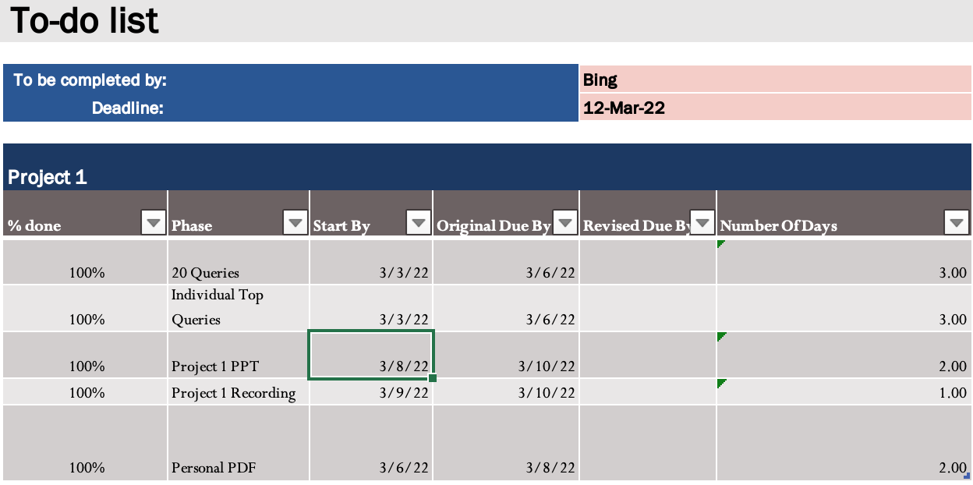
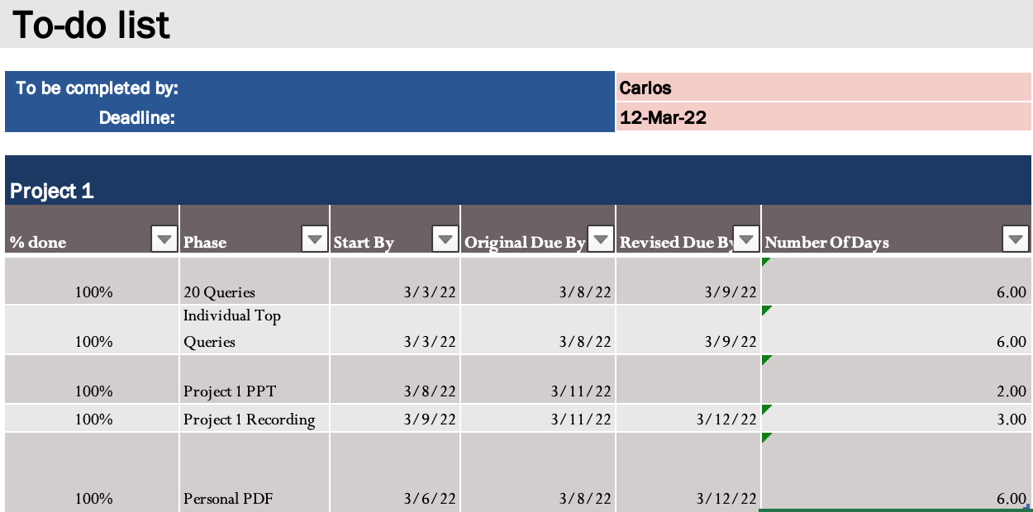
Individual to-do’s list
Individual Tasks
Progress Tracking
Deadlines
Completion Times
Insert 3 to-do’s

Slide 5
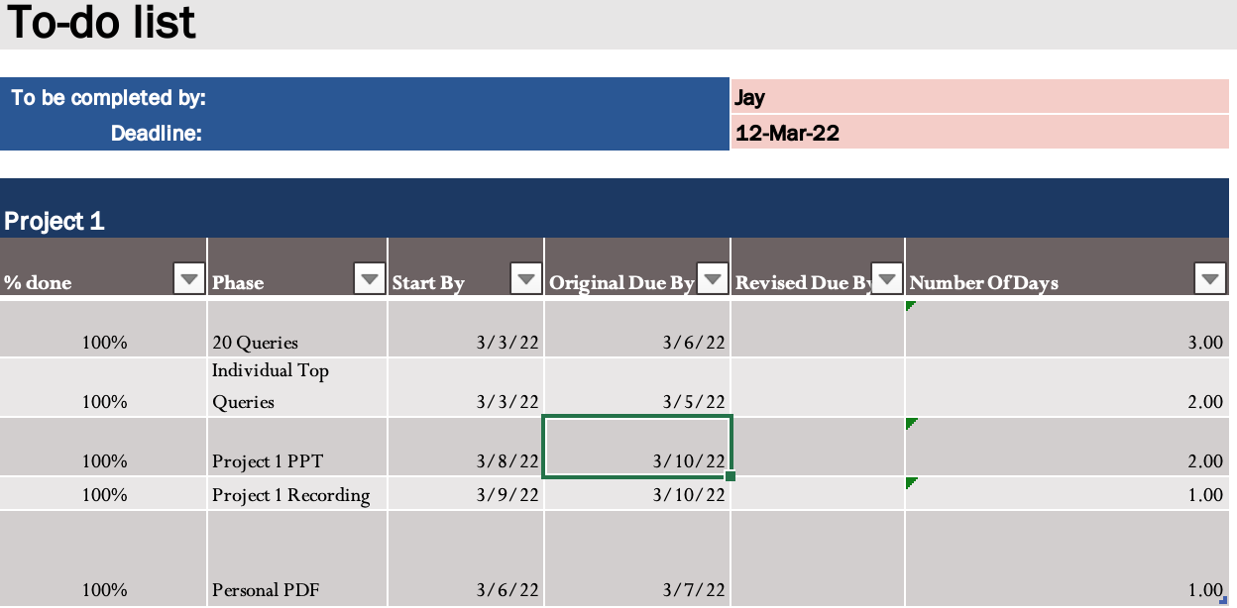
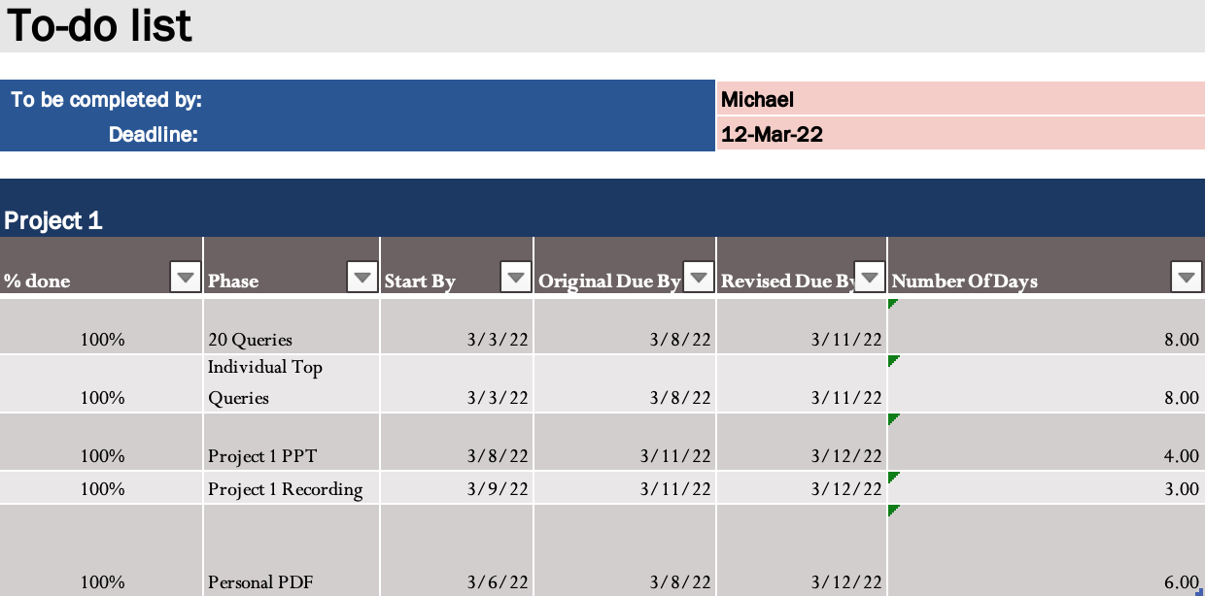
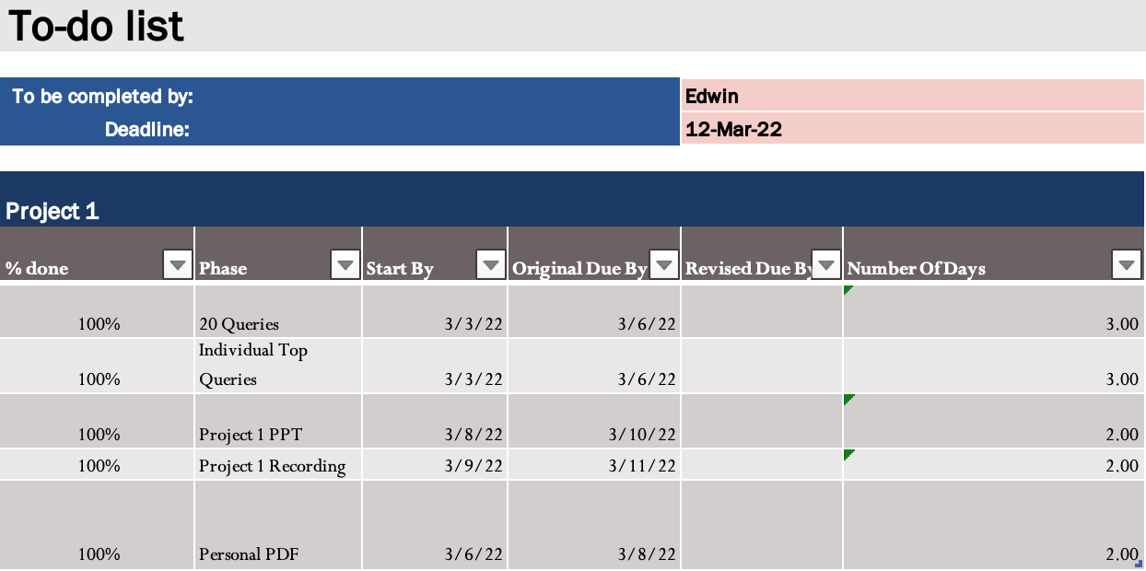
Individual to-do’s list
Individual Tasks
Progress Tracking
Deadlines
Completion Times
remaining todo’s here

Slide 6
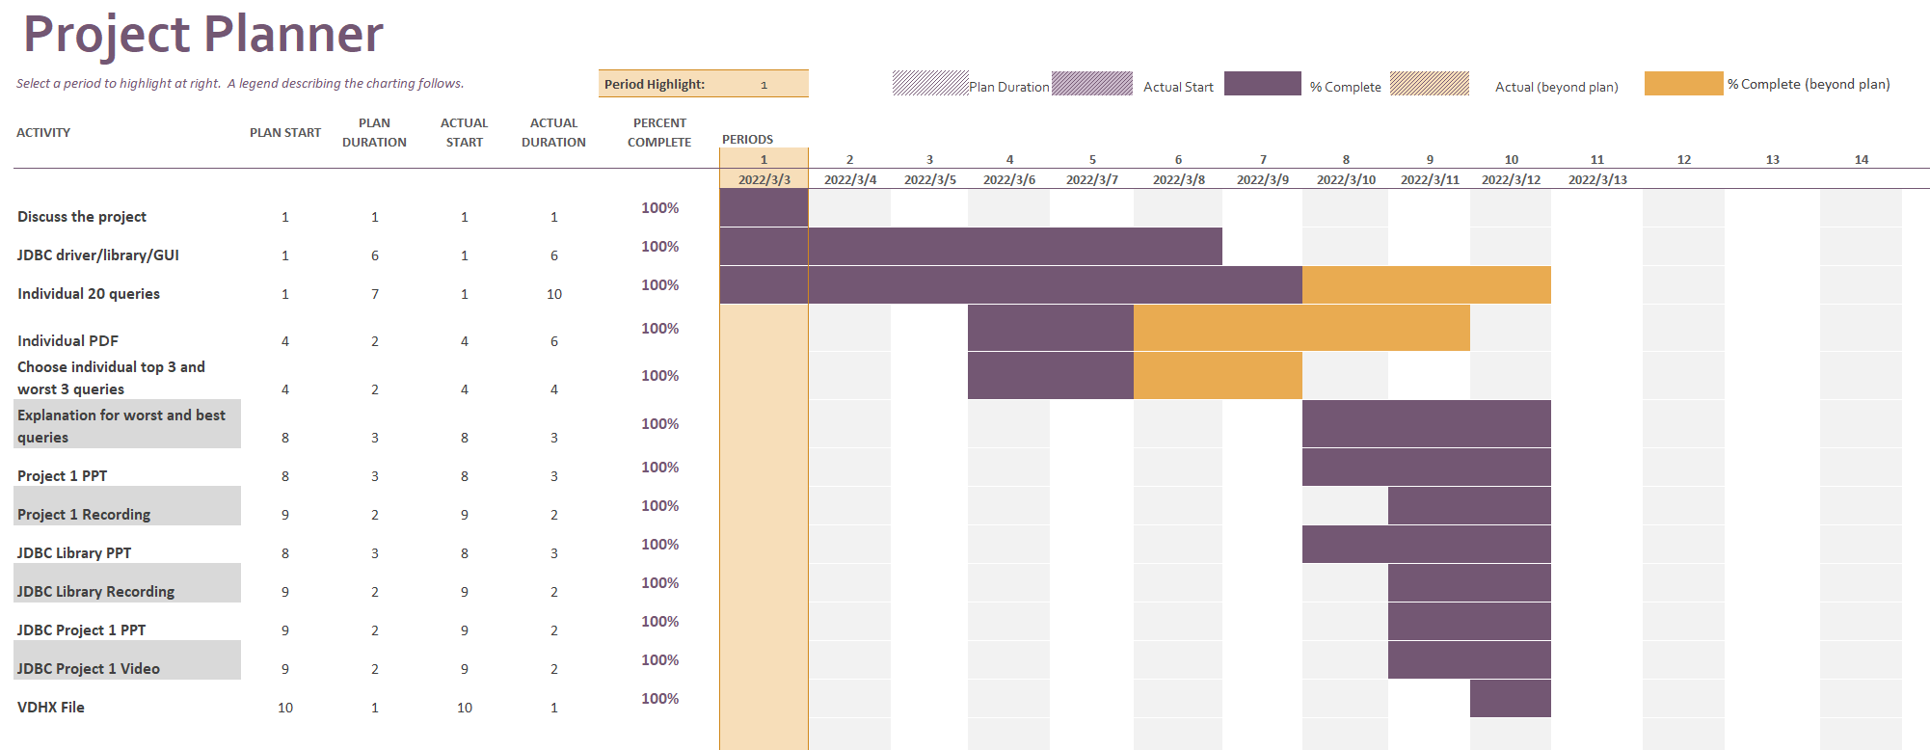
Project Planner
Task list for the group
Progress Tracking
Duration Tracking
Visual progress aids

Slide 7
Edwin Ramos Queries

Slide 8
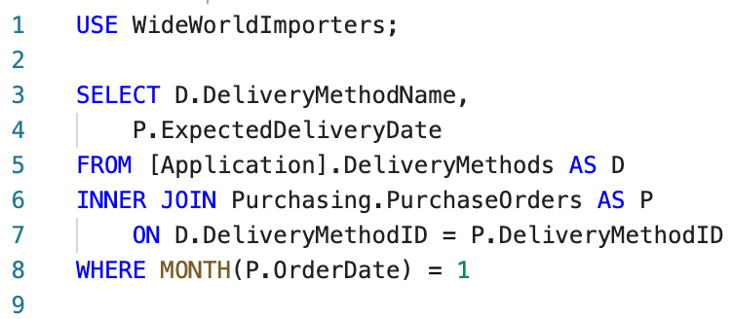
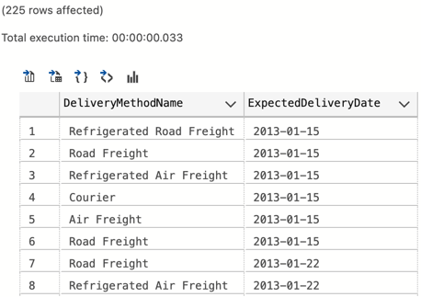
Query #1
Best Simple Query:
Inner join DeliveryMethods and PurchaseOrders Tables
This demonstrates a simple query that joins the tables above based on DeliveryMethodID
This pulls only results where the order was placed in January

Slide 9
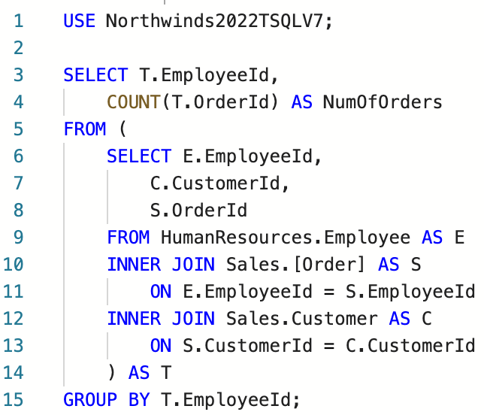
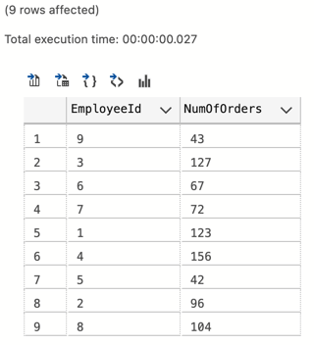
Query #2
Best Medium Query:
Inner join on Employee’s, Customer’s and Order’s based on the employee’s and Customer’s id’s per sale.
This demonstrates join between orders, customers and employees based on the keys given per order.
This query aggregates a count of orders based on the employee id on each order ever made, then shows them next to their employee id.

Slide 10
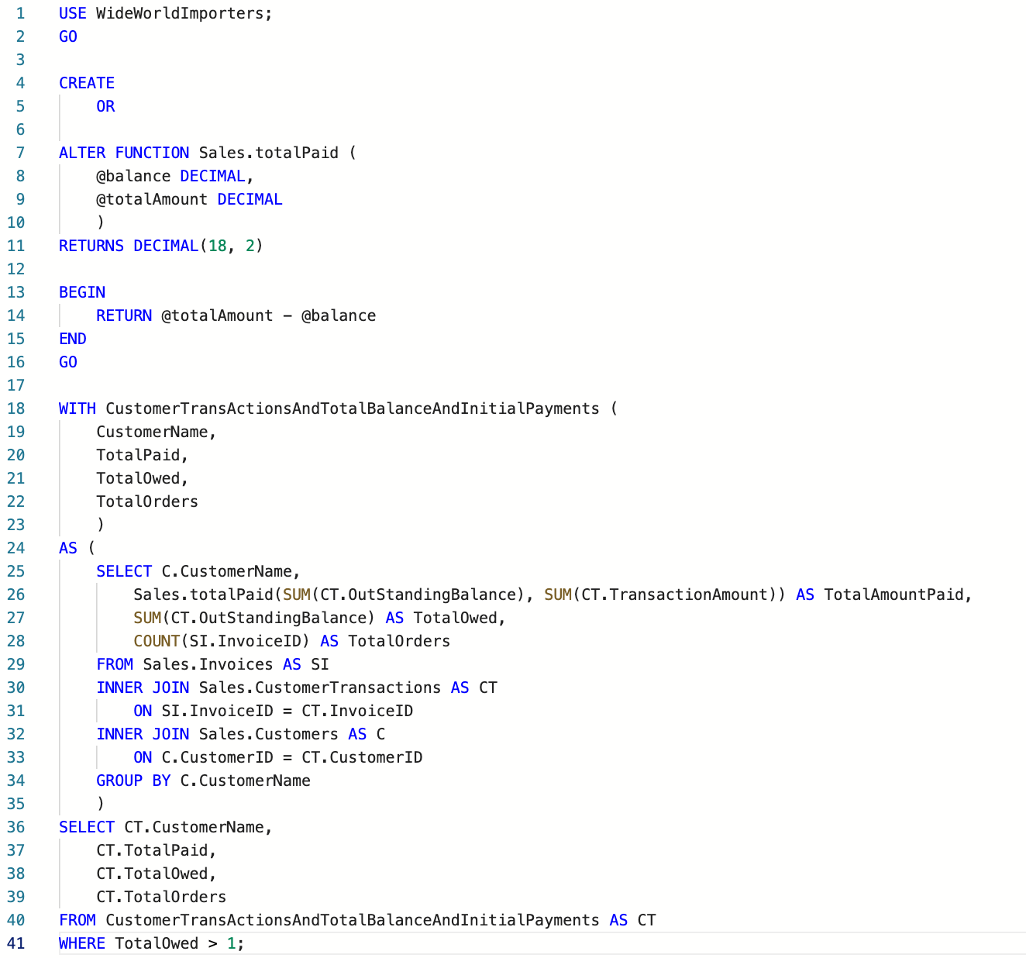
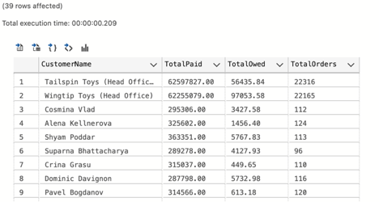
Query #3
Best Complex Query:
Create a table that joins Customer Transactions, Invoice’s, and Customer’s based on invoice and customer id’s on transactions.
Custom Scalar Function: totalPaid takes a balance and totalamount, to return a value that represents the amount a customer has paid to the company so far.
Returns table of companies that owe the company money, and how much they’ve paid so far

Slide 11
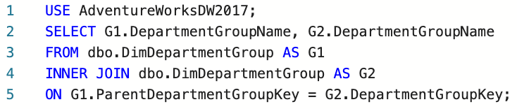
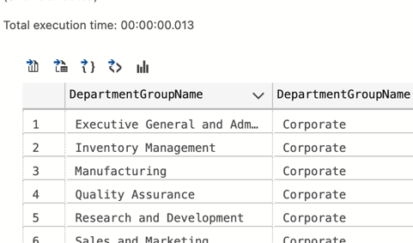
Query #4
Worst Simple Query:
This joins Department group with itself on an available non-null parent key.
The query unfortunately does not tell us much because all of the departments lead back to one parent in corporate.
The query is also not very readable, could be formatted better. Columns could be named.

Slide 12
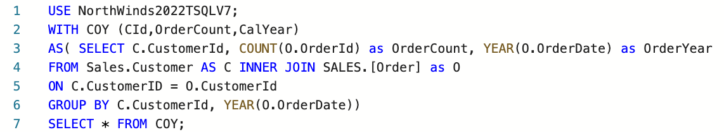
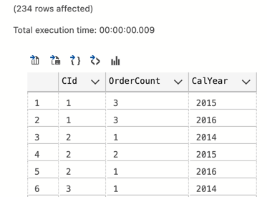
Query #5
Worst Medium Query:
We create a cte called COY, Which is supposed to CustomerOrdersYearly. That returns a table the count of order id’s and the year of the order date’s plus the customer id from Sales.customer and Sales.Order.
You then group that table above from CustomerId and Year OrderDate.
After that you select everything from that table.
This query is not very well formatted and we don’t like using the * operator.

Slide 13
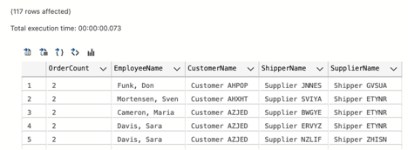
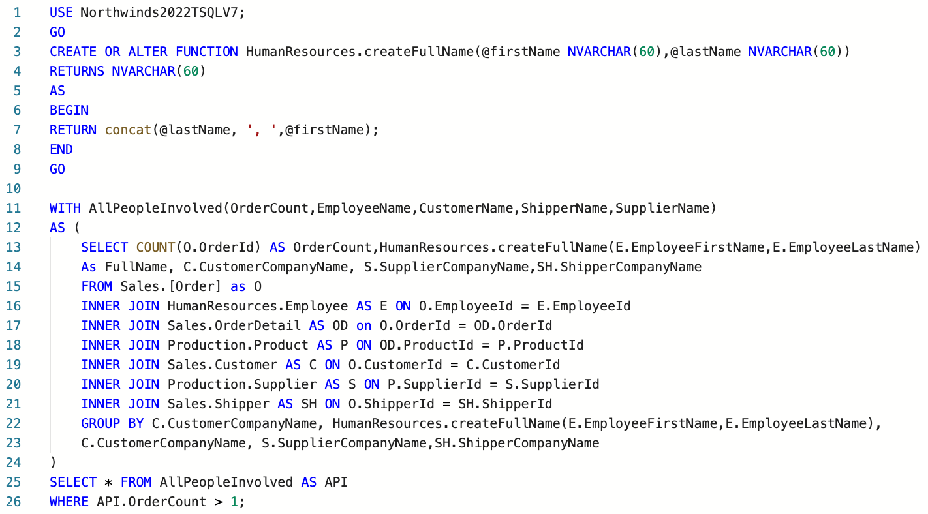
Query #6
Worst Complex Query:
We have a function called createFullName, which takes a first and last name and concatenates then with a comma in the middle.
The query itself creates a cte called all people involved, it presents information about the different combo’s of suppliers, customers, employee’s and shippers.
It’s supposed to tell you how many orders a combination of those entities have done together.
I’m not a fan of joining that any tables for a single query, there’s probably a better way to do that.
Not a fan of the formatting also, and once again i use the * operator instead of naming what i need out of the CTE.

Slide 14
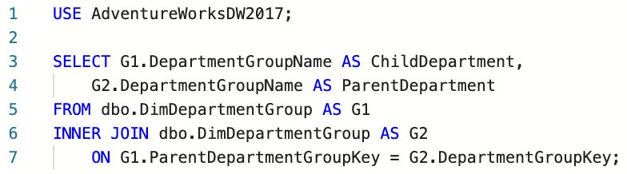
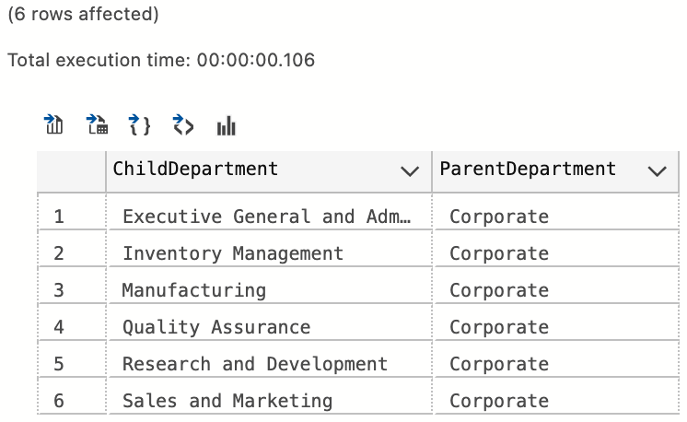
Query #7
Corrected Worst Simple Query:
We added named columns to the original query to differentiate parent from kid.
Formatted the query better for readability purposes.

Slide 15
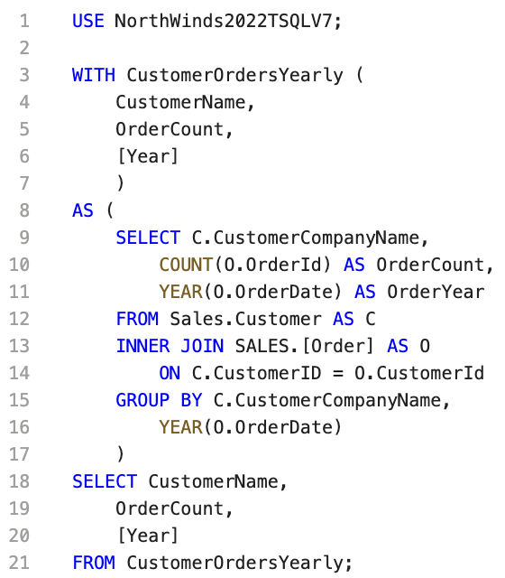
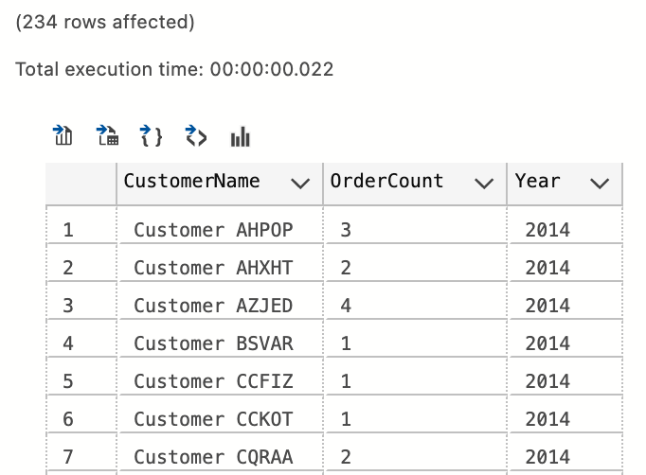
Query #8
Corrected Worst Medium Query:
We formatted the code better for readability.
Renamed COY to what it’s actually supposed to be called, CustomerOrdersYearly.
We got rid of the * operator from the SELECT clause in the last query, to be very specific about what we need.

Slide 16
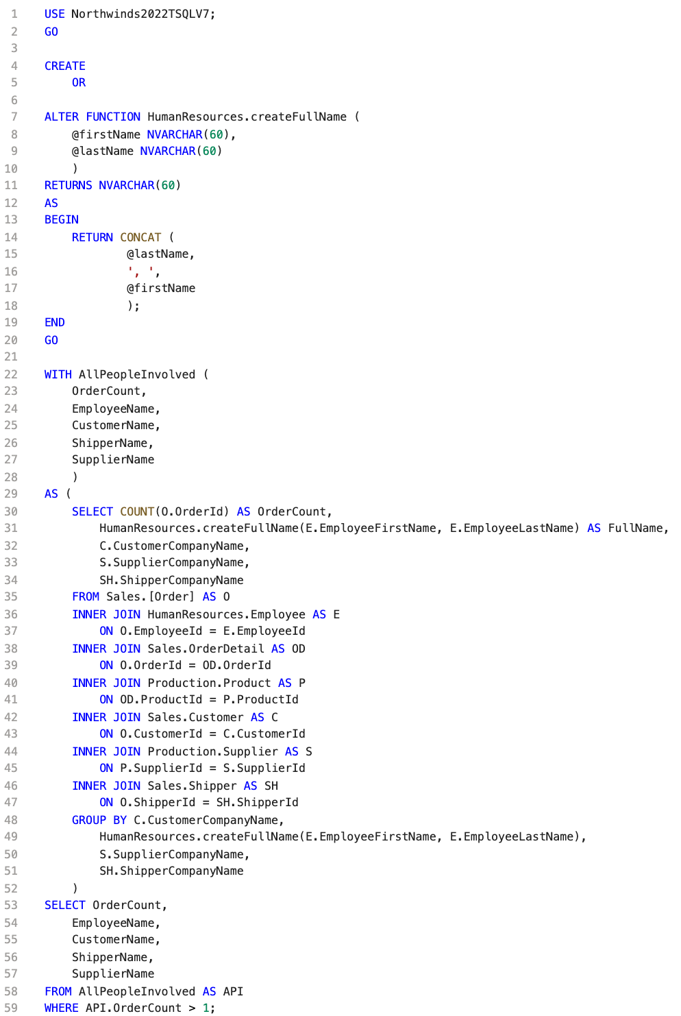
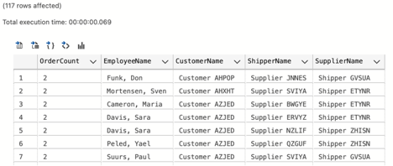
Query #9
Corrected Worst Complex Query:
Formatted code for better visibility.
We do not use the * operator on the finishing query, and specify exactly what we need from the core CTE.
Renamed API CTE to something more informative such as AllPeopleInvolved, no more ambiguous names.

Slide 17
Jay Mistry Queries

Slide 18
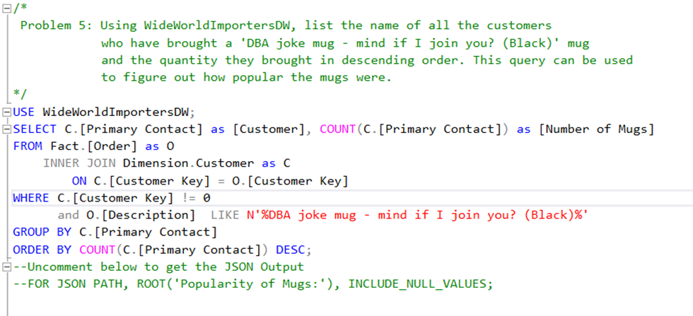
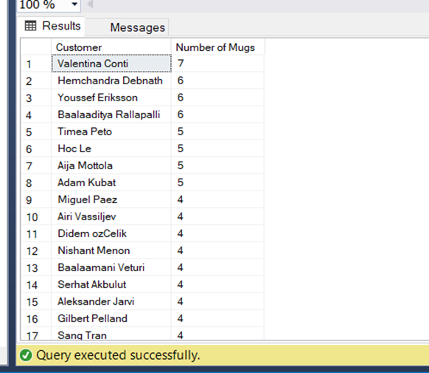
Best Query 1

Slide 19
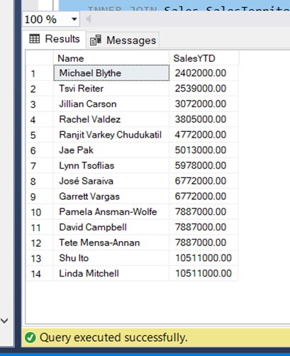
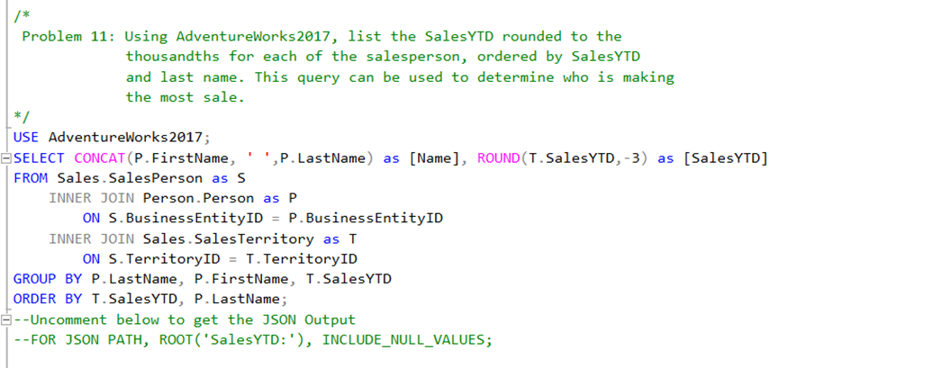
Best Query 2

Slide 20
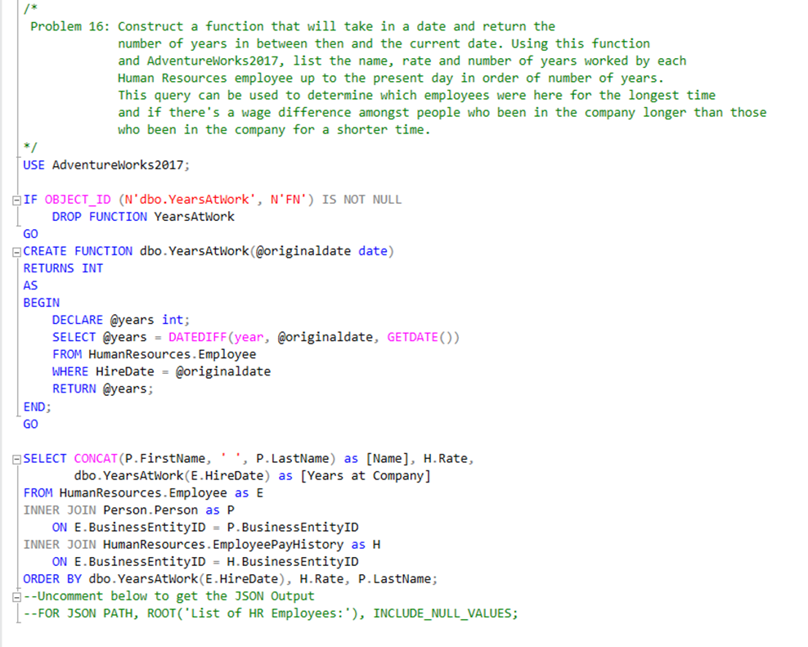
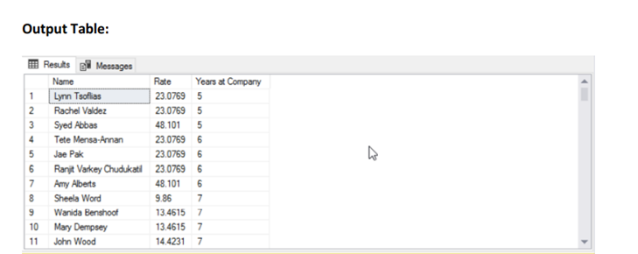
Best Query 3

Slide 21
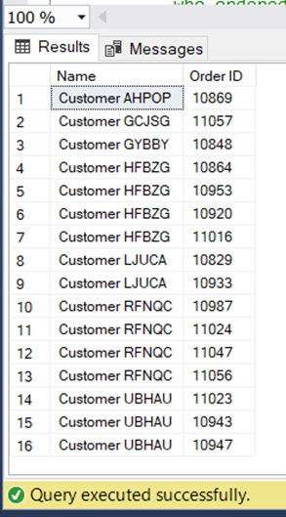
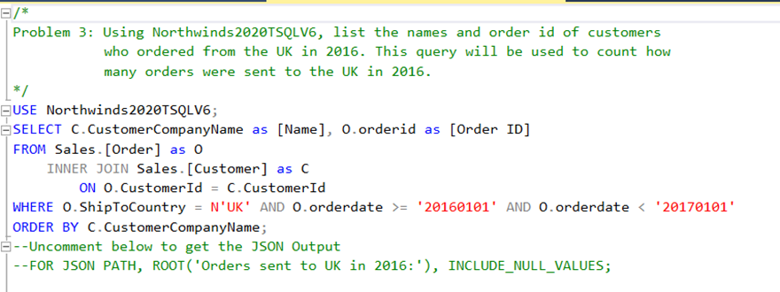
Worst Query 1

Slide 22
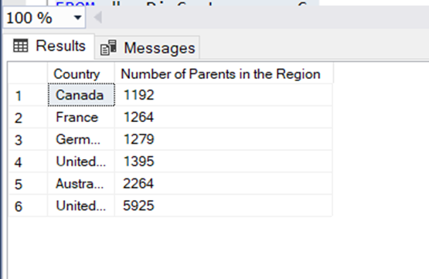
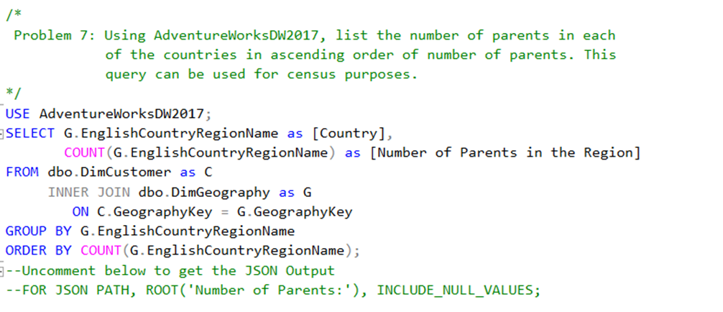
Worst Query 2

Slide 23
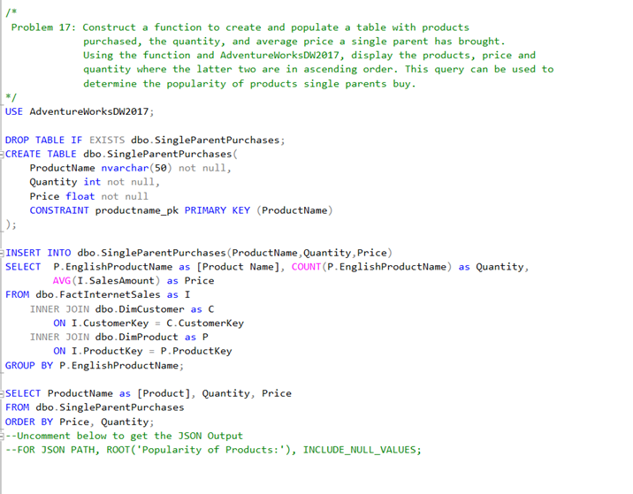
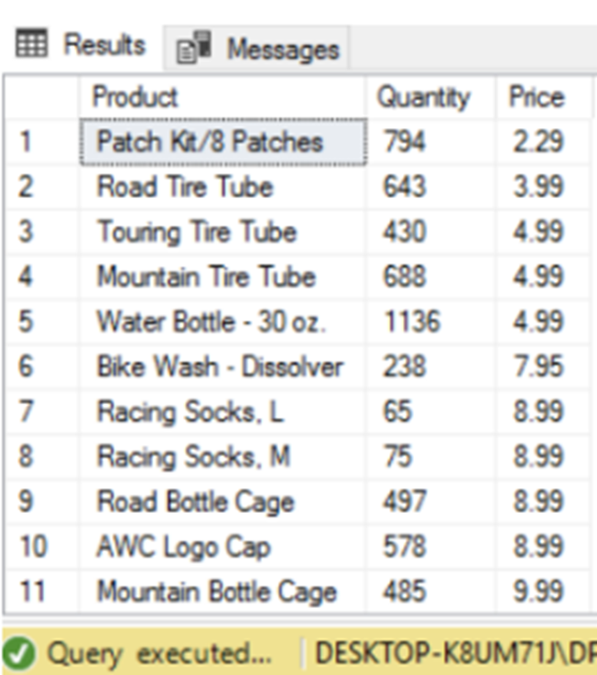
Worst Query 3

Slide 24
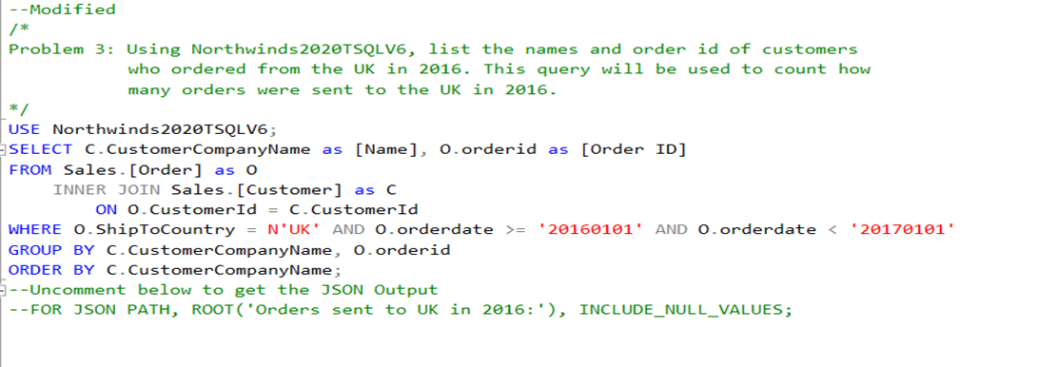
Worst Query 1 Corrected

Slide 25
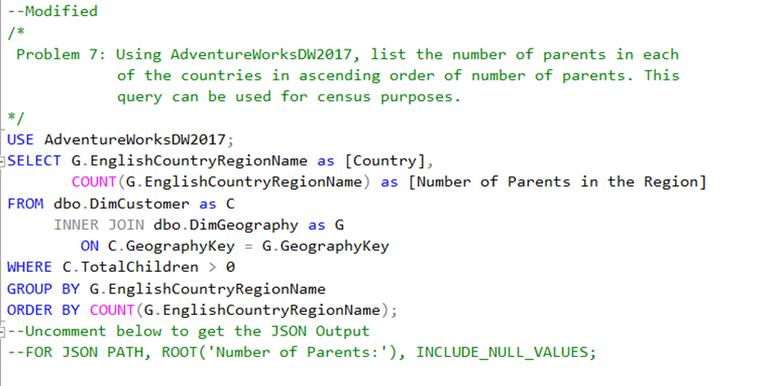
Worst Query 2 Corrected

Slide 26
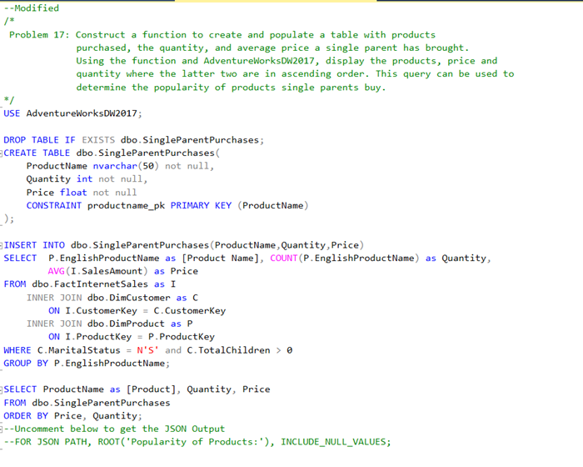

Worst Query 3 Corrected

Slide 27
Bing Gao Queries

Slide 28
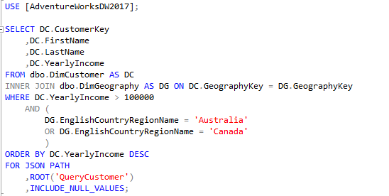
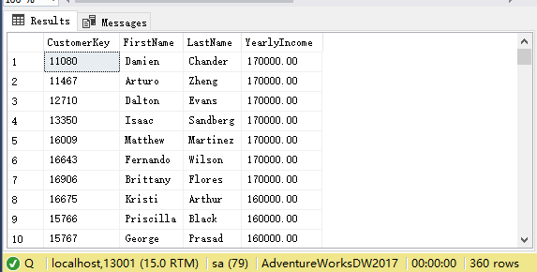
Query #1
Display the customers with yearly income over 100,000 from Australia or Canada
Inner join between tables dbo.DimGeography and dbo.DimCustomer
This query shows a simple inner join through match the common key GeographyKey from both tables
Best Simple Query

Slide 29
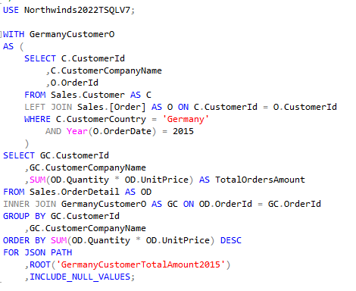
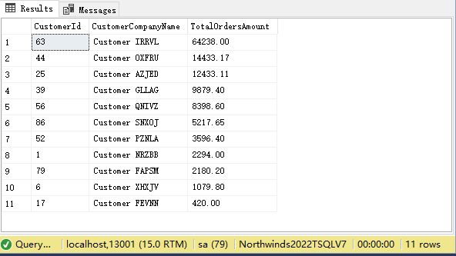
Query #2
This query displays Germany customers total order amount in 2015
It uses WITH clause to create a temporary table GermanyCustomerO through left join between tables Sales.Customer and Sales.Order
GermanyCustomerO table stores the information of German customers order in 2015 then Inner join to the temporary table through matching orderId and use Sum function to get the total amount
Best Medium Query

Slide 30
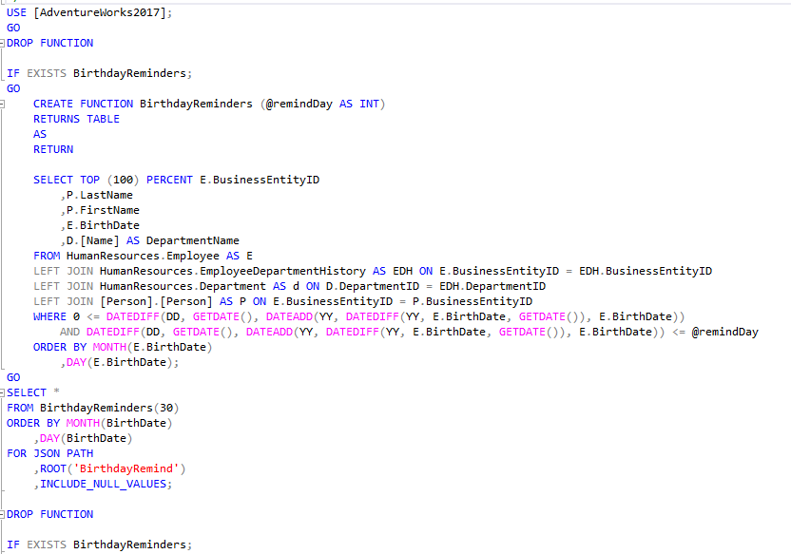
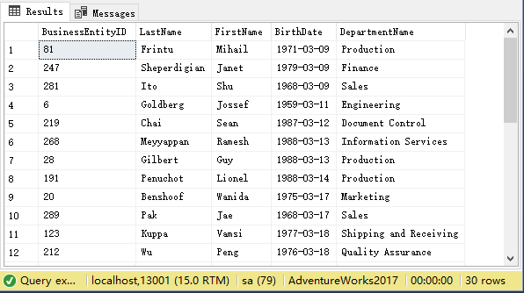
Query #3
Create a table that display employees whose birthdays are coming up through input remind days
Function parameter: @remindDay
GETDATE(): Get the current time
DATEDIFF(): Get the number of days difference
Order the employees by the number of days until the birthday
Best Complex Query

Slide 31
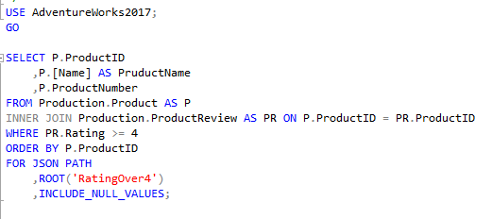
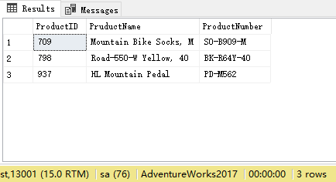
Query #4
Display the products which rating equal or more than 4
Inner join between tables Production.Product and Production.ProductReview through matching the common key ProductID
Disadvantages: The query results are not reliable
Worst Simple Query

Slide 32


Query #5
Display the products which rating more than 3 and the total order for this product is over 50
Filter out products with orders no less than 50 by subquery
Advantages: Increase the reliability of reviews
Corrected Simple Query

Slide 33


Query #6
Display each customer that total order amount in 2014
Left join three tables Sales.Order, Sales.Customer and Sales.OrderDetail through matching the common key OrderId and CustomerId
Disadvantages: year() is not efficient, total amounts calculate without discount, unclear order
Worst Medium Query

Slide 34


Query #7
Display each customer that total order amount (after discount) in 2014
Advantages: More efficient than worst medium query through changing the where condition, format the total amount
Corrected Medium Query

Slide 35


Query #8
Distinguish the different level through the sales amount of per employee
Left join three tables Sales.Order, Sales.Customer and HumanResources.Employee
Custom-Scalar Function: Determine the sales level of employees by passing on their total sale amount
Disadvantages: Usually the sales level is also tied to the sales experience, Unclear order
Worst Complex Query

Slide 36


Query #9
Distinguish the different level through the sales amount of per employee and year of work
Custom-Scalar Function: Determine the sales level of employees by passing on their total sale amount and year of work started by hire date
Add conditions for more detailed classification of sales levels
Corrected Complex Query

Slide 37
Michael Chang Queries

Slide 38


Query #1 Best Simple
Obtain salaries of top 100 employees organized in each job title, gender and descending order of salary. 100 employees are queried to include positions with multiple occupancies.
Inner joins the HumanResources.Employee and HumanResources.EmployeePayHistory tables on the shared BusisnessEntityID attribute.

Slide 39


Query #2 Best Medium
Employee information is too scattered across multiple tables.
Create an aggregate/centralized employee contact table containing Employee ID, first name, middle last name, email, home phone number, full address.
Inner Joins multiple tables together, and joins multiple attributes into one field via CONCAT() function in a easily readable style, organized

Slide 40



Query #3 Best Complex
Refined version of similar queries direction of inquiry. Summarization of a employee's salary, years worked, job title, department, shift and gender.
Uses a CTE to modularize a tableset whose components are more interconnected to one another.
Removes need of multiple cross joins seen in a previous version(Q15), or using a different table as the "base" for inner joins.
Though requires more corroboration, can be used to determine discrepancies in salary across multiple attributes, rather than individual ones.

Slide 41


Worst Query #1
Simple
Find the customers who have recieved large discounts of 20% or greater and what they purchased
Use tables Sales.[Order] and Sales.OrderDetail
Readability of the query is relatively poor due to attributes being displayed in such a format

Slide 42


Worst Query # 2
Medium
Identify if there is a regional demand for specific parts in internet purchases.
Joins Tables dbo.DimProduct, dbo.FactInternetSales, dbo.SalesTerritory.
Calculates the amount of each product sold through SUM() aggregate function, organized by Group, Territory and Region
Readability is extremely poor due to the length of the original column names and given aliases.
Query relies on GROUP BY for sorting, there is no ORDER BY statement.

Slide 43



Worst Query #3 Complex
Read Order: Top Left Bottom Left
Top Right

Slide 44

Query a table that displays customer facing order details.
The table will show customerID, CustomerTransactionID, invoiceID, description of the item, quantity purchased, unit price and carrier class used for the shipment.
The carrier class uses 3 functions to determine the carrier classification which should handle the shipping of each order
Joins tables Sales.CustomerTransactions, Sales.Invoice, Sales.InvoiceLines
It literally does not work as intended.
There is a logic/syntax flaw in the MAX() statement
Having quadruple nested functions it takes a EXTREMELY long time to process. (~ 20 sec)
Worst Query #3 Complex (Cont)

Slide 45

Worst Query #1 Simple Corrected
Query behaves the same as before.
Minor adjustments to the format of the attributes in SELECT for readability

Slide 46


Worst Query #2
Medium Corrected (REDO)
Query remains functionally the same as the original version.
Changes in formatting, vastly improved readability
Added an ORDER BY STATEMENT for stronger sorting

Slide 47


Worst Query #3 Complex Corrected
Read Left then right

Slide 48

Worst Query #3 Complex Corrected (Cont)
Due to time constraints, the query intent was not completed.
The provided correction is a revision/rollback of the query.
It actually functions as intended/seen in the results.
This rollback version of the query only takes 6 seconds to complete.
The “attempted” improvement was to “bundle” all items under the same CustomerTransactionID as the highest “tier” of carrier.
This was intended to prevent orders from being shipped out piecemeal under multiple carriers.

Slide 49
Carlos Salinas Queries

Slide 50


Best Query 1
Best Simple Query:
Shows how many orders each shipping company handles
COUNT(O.OrderID)
INNER JOIN ON ShipperId

Slide 51


Best Query 2
Best Medium Query:
Shows reasons why a sale was made and how many sales were generated from these reasons
Shows that Price is biggest reason for sales
INNER JOIN to COUNT the sales from SalesReason
RIGHT OUTER JOIN to show that Marketing is not a reason for sales except TV ads

Slide 52


Best Query 3
Best Complex Query:
Displays the amount of money from rejected units and which purchaseID they are from
@rejectedAmt: Calculates the amount
ROUND(), ShipMethod.Name
RejectedQty > 0
Notes:
ShipMethod.Name is there to help know which shipping company to work with

Slide 53


Worst Query 1
Worst Simple Query:
No way to distinguish who exactly the pay belongs to
The Total Pay can be formatted better
Doesn’t really tell us much about the person and reasons they make that much
Notes:
(316 rows affected)
Completion time: 2022-03-11T15:10:55.4101840-05:00

Slide 54


Worst Query 2
Worst Medium Query:
Shows employees and the countries that they work and ship to
One giant list, not very practical
Employee is repeated a lot

Slide 55


Worst Query 3
Worst Complex Query:
Displays BusinessEntityIDs that have Vista credit cards
@isVisa: Checks if a card is Vista and returns true or false

Slide 56


Worst Query 1
Corrected
Worst Simple Corrected Query:
Returns their full names and job title
Total Pay now is rounded up
Better understanding of the pay grade based on more information presented

Slide 57


Worst Query 2
Corrected
Worst Medium Corrected Query:
Using an Argument to easily find which Employees worked with which country
No longer a huge list of information but rather a quick look up
Has more flexibility and you can pick which country

Slide 58


Worst Query 3
Corrected
Worst Complex Corrected Query:
INNER JOIN Sales.SalesOrderHeader
FullName, SUM()
@isVisa = True

Slide 59
Akashdeep Singh Queries

Slide 60


Best Query 1
Best Simple:
Shows info on resellers based in USA
Displays ResellerName, CountryRegionCode, and EnglishCountryRegionName
Inner Join on GeographyKey from the tables: dbo.DimGeography & dbo.DimGeography

Slide 61


Best Query 2
Best Medium:
Shows the average income of every level of education in the USA
Displays EnglishEducation, EnglishCountryRegionName, and AverageYearlyIncome
Inner Join on Geography Key on tables dbo.DimCustomer and dbo.DimGeography
Orders from lowest to highest depending on AverageyYearlyIncome for better readability

Slide 62


Best Query 3
Best Complex:
Shows YearsOfService for each employee in company
Display FirstName, LastName, JobTitle, YearsInCompany, and Rate
Inner Join on BusinessEntityId on tables HumanResources.Employee, Person.Person, and HumanResources
Uses scalar function to determine how many years an employee has been in employment using HIreDate. The function goes into depth by calculating the days as well to get a precise integer to output as years of service to the company on the employee’s half

Slide 63


Worst Query 1
Worst Simple:
Shows all orders placed in the month of December
Displays OrderId and OrderDate
Inner Join on OrderId from tables Sales.OrderDetail and Sales.Order

Slide 64


Worst Query 2
Worst Medium:
Shows people in Human Resources’ information
Display FirstName, LastName, HireDate, and Rate
Inner Join on BusinessEntityId from tables Person.Person, HumanResources.Employee, and HumanResources.EmployeePayHistory

Slide 65


Worst Query 3
Worst Complex:
Shows the total amount of orders placed for each customer
Displays CustomerContactName, TotalOrdersPlaced, and TotalSpent
Inner Join on CustomerId and OrderId on tables: Sales.Order, Sales.Customer, and Sales.OrderDetail
Scalar function counts the total number of order for each customer depending on id
TotalSpent column sums up the all time amount of how much each customer has spent on the platform and siplays it along with the total all time orders placed

Slide 66


Worst Query 1 Corrected
Worst Simple Fixed:
Shows all orders placed in December along with a condition limiting the quantity
Displays OrderId, Quantity, and OrderDate
Inner Join on OrderId on tables: Sales.OrderDetail and Sales.Order

Slide 67


Worst Query 2 Corrected
Worst Medium Fixed:
Shows people in HumanResources’ history reordered by the precedence in the group by clause
Dsiplays FirstName, LastName, HireDate, and Rate
Inner Join on BusinessEntityId on table: Person.Person, HumanResources.Employee, and HumanResources.EmployeePayHistory
The group by clause takes precedence with HireDate before other columns

Slide 68


Worst Query 3 Corrected
Worst Complex Fixed:
Shows in depth analysis of Customer information
Displays CustomerId, CustomerContactName, TotalOrdersPlaced, and TotalSpent
Inner Join on CustomerId and OrderId on tables: Sales.Order, Sales.Customer, and Sales.OrderDetail
Scalar function used to count all time orders and sum used to add up total all time money spent by customer
Orders CustomerId for better readability since its a primary key

Slide 69
SQL is a very powerful tool
TSQL Enhances it with great utilities
Writing good queries requires solid fundamental knowledge of databases and SQL
Project Takeaways

Slide 70

Thanks!

